Slide 1


BariatricPath
A Clinical Evaluation Management System
CODE WALKTHROUGH
CS673 Software Engineering · Team 1 · Summer 2026
Presented by: Jianing Li, Kolya Gavlishin, Shaima Nimeri, Fatimah Hassan, & Kai Fernandes

Slide 2
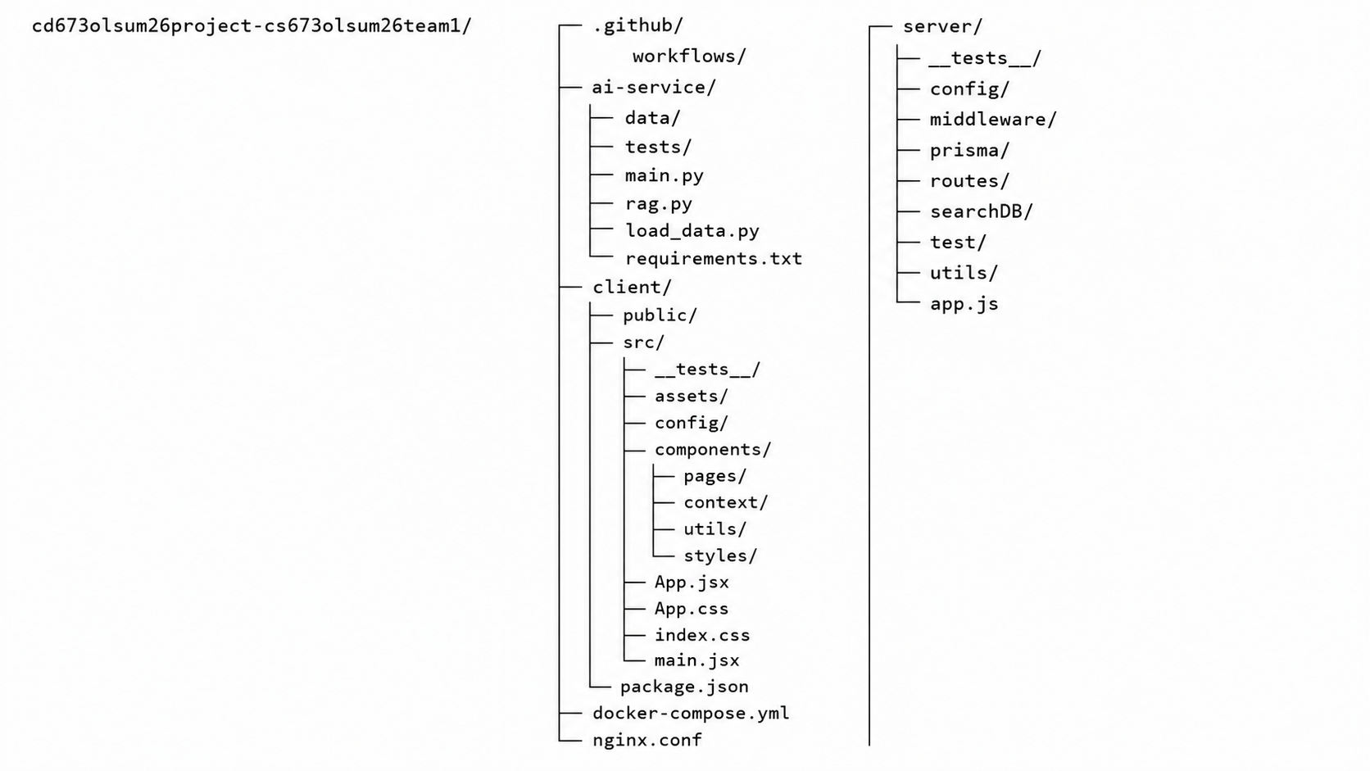
CODE WALKTHROUGH
Project Structure
CS673 · Team 1 · Iteration 3

Slide 3


01
Code Walkthrough
How we structure, design, implement, test and deploy
CS673 - Team 1 - BariatricPath - Final Iteration - Summer 2026
8

Slide 4





WALKTHROUGH
User Registration & Authentication
Implemented in: server/routes/auth.js, client/src/pages/Register.jsx, client/src/context/AuthContext.jsx
server/routes/auth.js - atomic registration
router.post('/register', async (req, res) => {
// 1. Verify the Firebase ID token
const decoded = await admin.auth()
.verifyIdToken(req.body.idToken);
// 2. User + Patient + AuditLog together,
// or not at all
const result = await prisma.$transaction(
async (tx) => {
const user = await tx.user.create({
data: {
firebaseUid: decoded.uid,
email: decoded.email,
name: req.body.name,
role: 'PATIENT',
},
});
const patient = await tx.patient.create({
data: {
userId: user.id,
dateOfBirth: req.body.dateOfBirth,
},
});
await tx.auditLog.create({
data: {
userId: user.id,
column: 'account',
newValue: 'created',
},
});
return { user, patient };
}
);
res.status(201).json(result);
});
1. Firebase creates the credential
Email/password or Google OAuth sign-up happens entirely in Firebase - we never touch or store a password.
2. Token sent to our API
The frontend gets a Firebase ID token and POSTs it (with name + DOB) to /api/auth/register.
3. Server verifies the token
admin.auth().verifyIdToken() confirms the token is real and not forged before any DB write happens.
4. One atomic transaction
User, Patient, and AuditLog are created together in a Prisma $transaction - if any step fails, all roll back. No orphaned records.
5. Role-based redirect
AuthContext listens via onAuthStateChanged, calls /api/auth/me for the role, and routes the user to their portal.
CS673 - Team 1 - BariatricPath - Code Walkthrough - Fatimah Hassan
2
Notes:
Speaking points: emphasize WHY the transaction matters - without it, a crash partway through could leave a User row with no Patient row, breaking the app for that account. Walk through the code top to bottom: token verification first (security gate), then the transaction (data integrity), then mention AuditLog is created here too - every account creation is logged from day one. Then switch to AuthContext.jsx briefly to show onAuthStateChanged and the /api/auth/me call, and ProtectedRoute/role redirect.

Slide 5


WALKTHROUGH
BMI Calculation & Specialist Recommendation
Implemented in: client/src/pages/BMICalculationPage.jsx, client/src/utils/bmi.js, client/src/pages/BMIForm.jsx
bmi.jsx - BMI Calculation component
BMICalculationPage.jsx - BMI eligibility page
export function calculateBMI(heightInches, weightPounds) {
if (!heightInches || heightInches <= 0) return null;
if (!weightPounds || weightPounds <= 0) return null;
return (weightPounds * 703) / (heightInches * heightInches);
}
1. BMI calculated from height & weight
// User enters height and weight
const heightInches = Number(height);
const weightPounds = Number(weight);
// Calculate and validate BMI
const bmi = calculateBMI(heightInches, weightPounds);
if (!bmi || isNaN(bmi)) {
showError('Please enter valid height and weight values.');
return;
}
setBmiResult(bmi.toFixed(1));
// Continue button
if (user?.patientId) {
try {
await PATCH(`/patients/${user.patientId}/bmi`, {
bmi: Number(bmiResult)
});
} catch {
showError('Failed to save BMI.');
return;
}
}
// Route based on eligibility threshold
if (Number(bmiResult) >= 27) {
navigate('/bmi', {
state: { bmi: bmiResult }
});
} else {
navigate('/bmi-ineligible', {
state: { ...user, bmi: bmiResult }
});
}
Height (inches) and weight (pounds) are passed to calculateBMI() to produce a standardized BMI score.
BMIForm.jsx - Specialist Recommendation Page
2. Input validation before processing
Invalid or missing values are caught early and displayed through toast notifications instead of browser alerts.
// On load
fetch patient record → prefill previousSurgery
// On form submit
POST { bmi, previousSurgery } → /recommendation
→ returns { primary, alternative }
// User selects a specialist, then confirms
PATCH /patients/:id/specialist { specialistChoice }
POST /patients/:id/submit
→ navigate to /thank-you/:id
// Routing logic (server-side)
if bmi < 27 → "Not eligible"
if bmi 27–34.9 → primary: Endocrinologist
if bmi 35–39.9 → primary: Surgeon, alt: Endocrinologist
if bmi ≥ 40 → primary: Surgeon
if previousSurgery → always route to Surgeon
3. BMI saved to patient record
The calculated BMI is saved to the patient's record through a PATCH request before moving to the next step.
4. Eligibility threshold check (>= 27)
Eligible patients (BMI>=27) navigate to the specialist form; others are routed to the ineligible page.
5. Specialist selection based on BMI
The selected specialist is PATCH'd to the patient's record, the form is POST-submitted, and the patient is navigated to the thank-you page.
CS673 - Team 1 - BariatricPath - Code Walkthrough - Fatimah Hassan
3

Slide 6
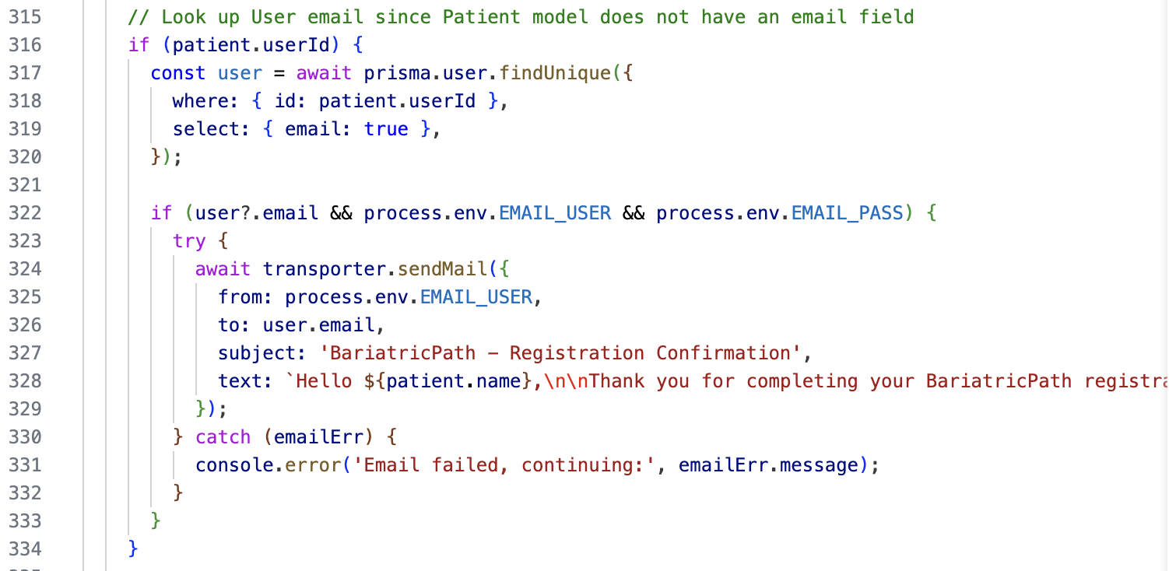
WALKTHROUGH - AI MICROSERVICE
Thank You Page & Automatic Email Notification-Jianing
application triggers a secure submit API request
Automated Nodemailer Integration
Polished Post-Registration UX

Slide 7
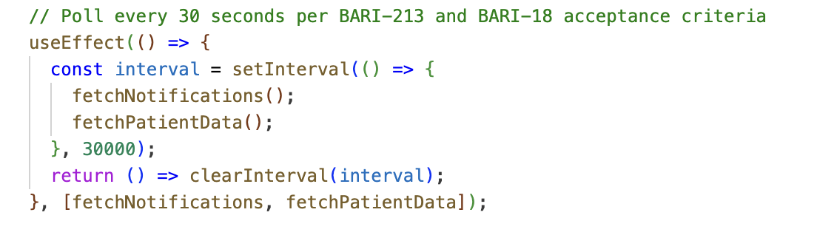
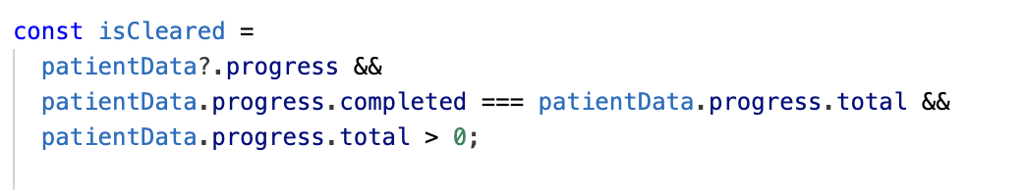
WALKTHROUGH - AI MICROSERVICE
Patient Portal Status Auto Update
No-Refresh User Experience
Adherence to Requirements & Resource Efficiency
Component Lifecycle Safety
Dynamic, Reactive UI Transitions:

Slide 8
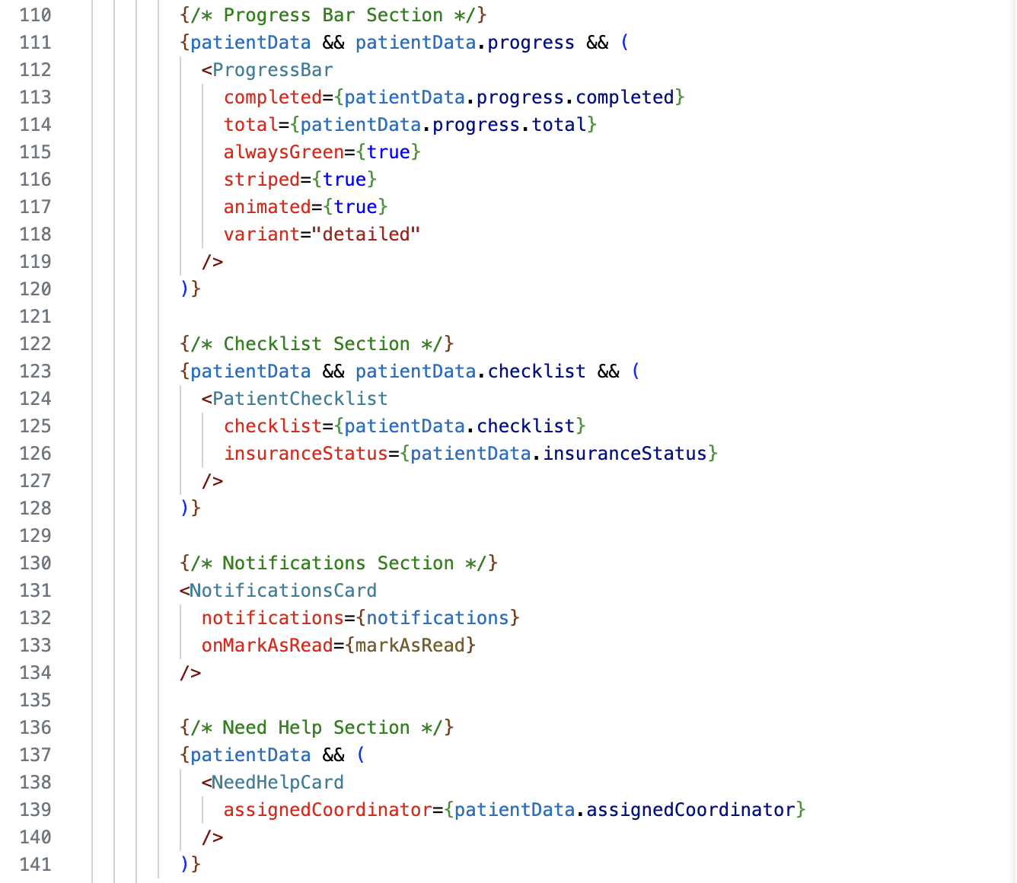
WALKTHROUGH - SECURITY & CONFIGURATION
Patient Portal Refactoring- Jianing
Transitioned the Patient Portal page from a single monolithic file of over 500 lines to a slim container component (~150 lines) that delegates rendering to focused sub-components.
6

Slide 9
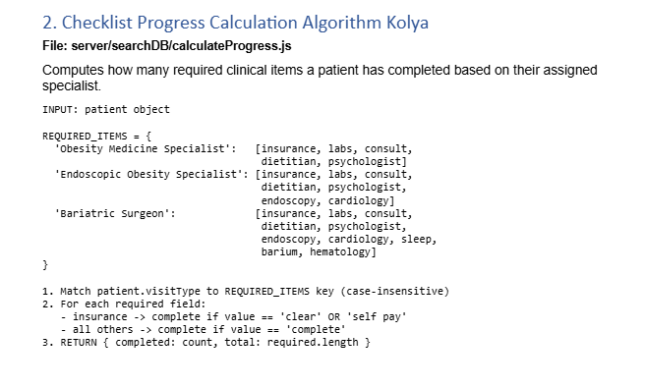
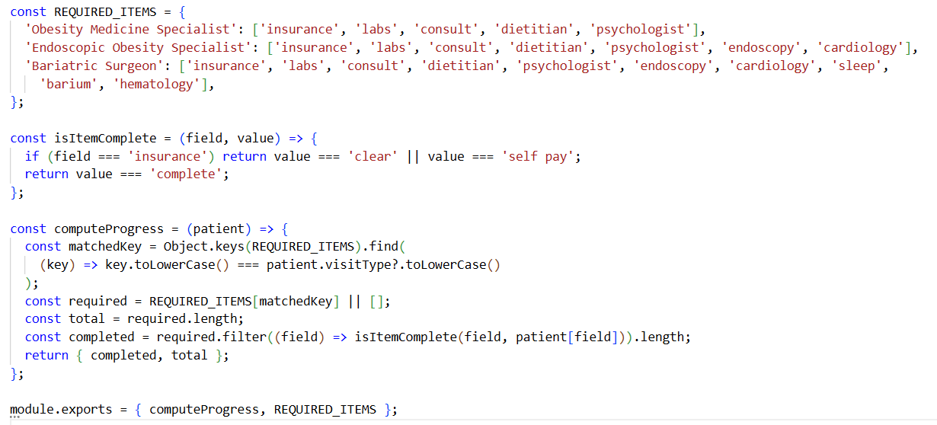
CODE WALKTHROUGH
Patient Portal & Checklist Progress
server\searchDB\calculateProgress.js
CS673 · Team 1 · Iteration 3

Slide 10
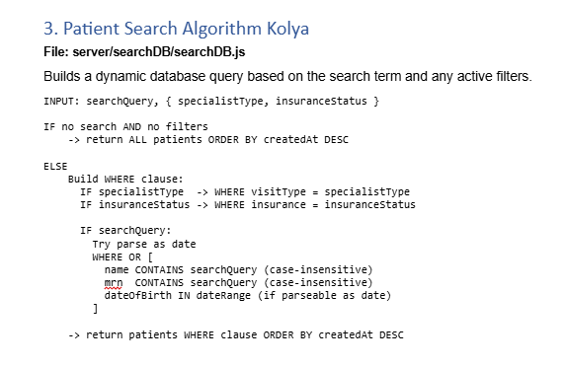
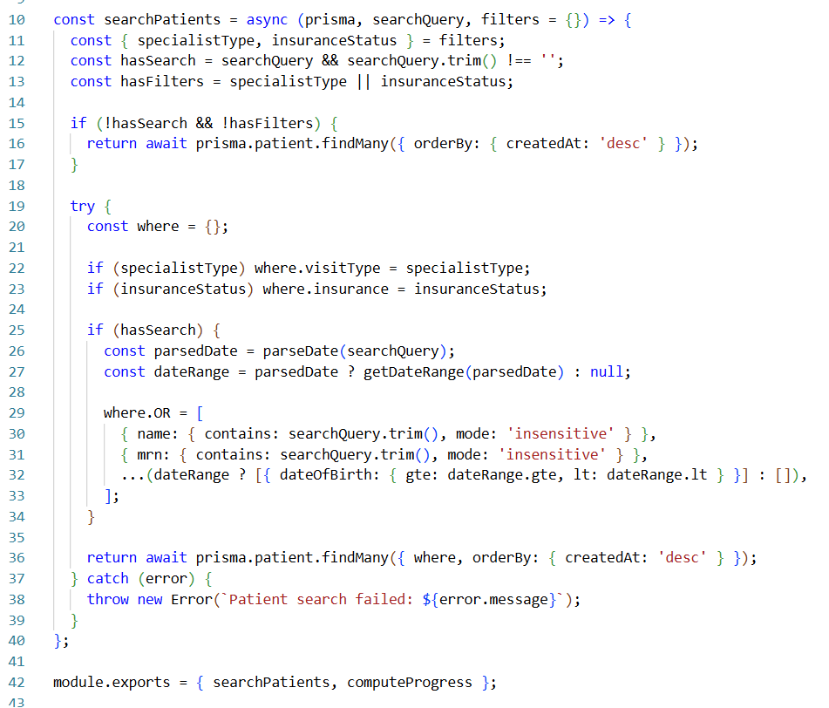
CODE WALKTHROUGH
Coordinator Dashboard & Patient Search
server\searchDB\searchDB.js
CS673 · Team 1 · Iteration 3

Slide 11
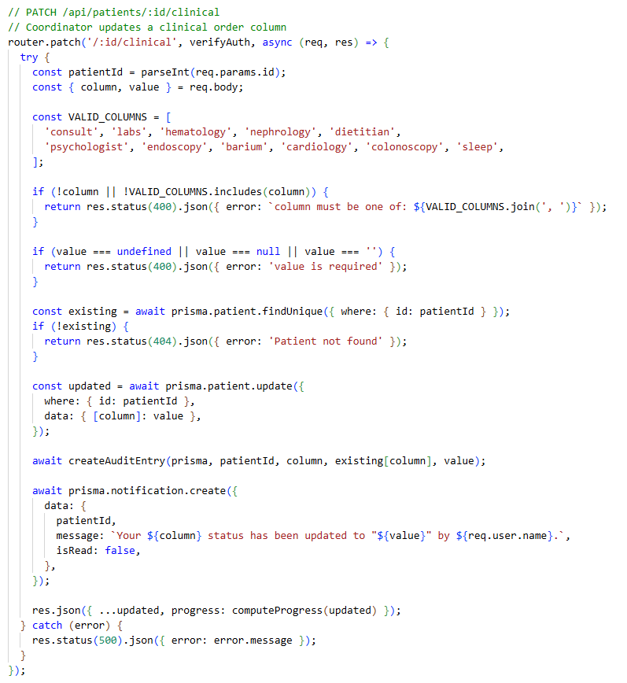
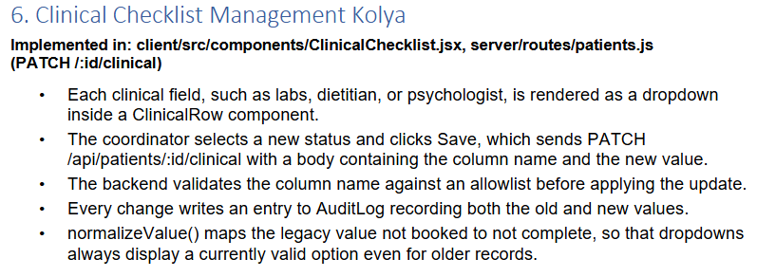
CODE WALKTHROUGH
Clinical Checklist Management
client/src/components/ClinicalChecklist.jsx, server/routes/patients.js (PATCH /:id/clinical)
CS673 · Team 1 · Iteration 3

Slide 12
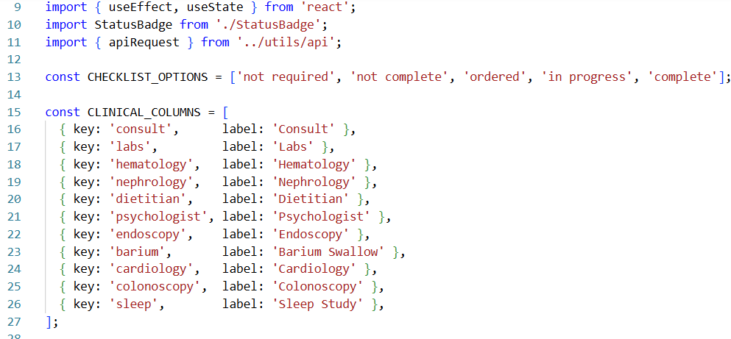
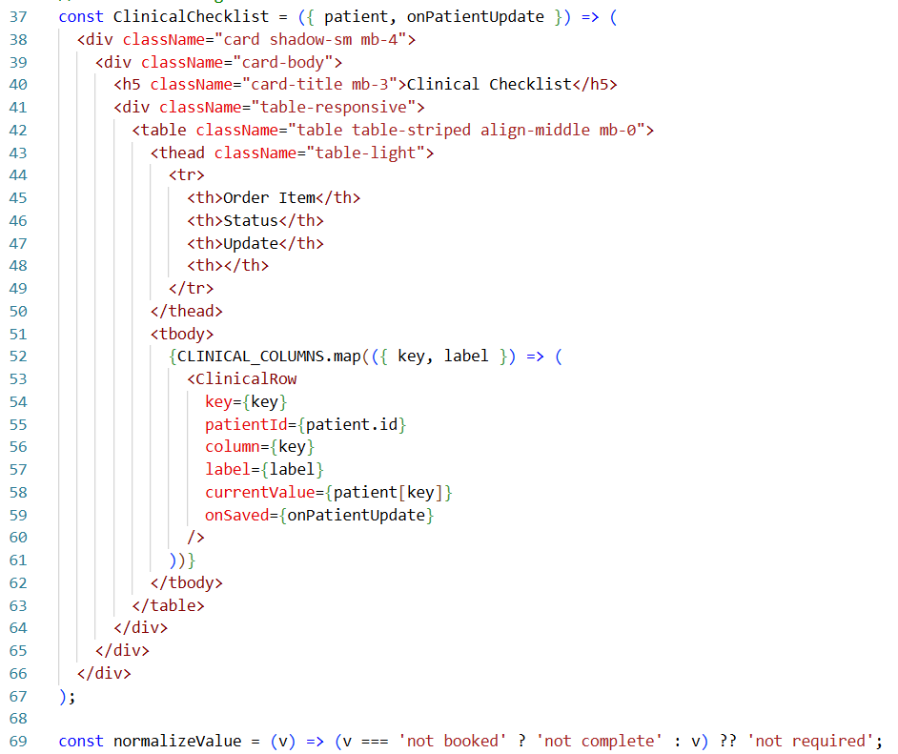
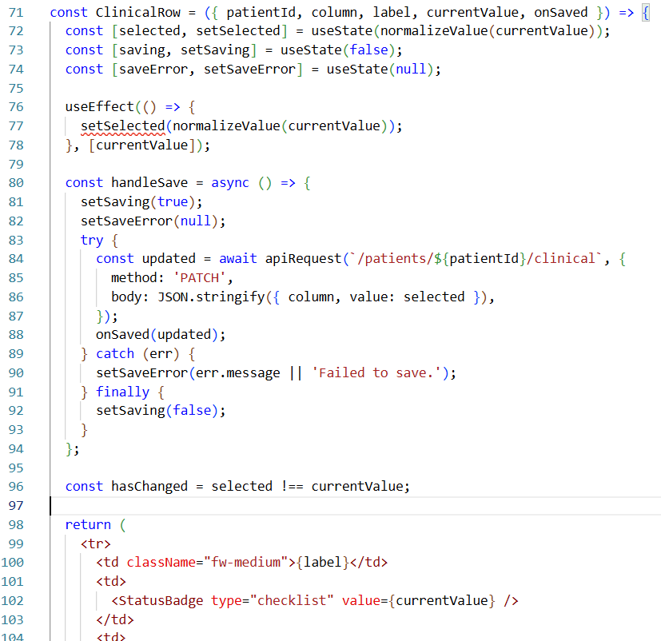

Slide 13
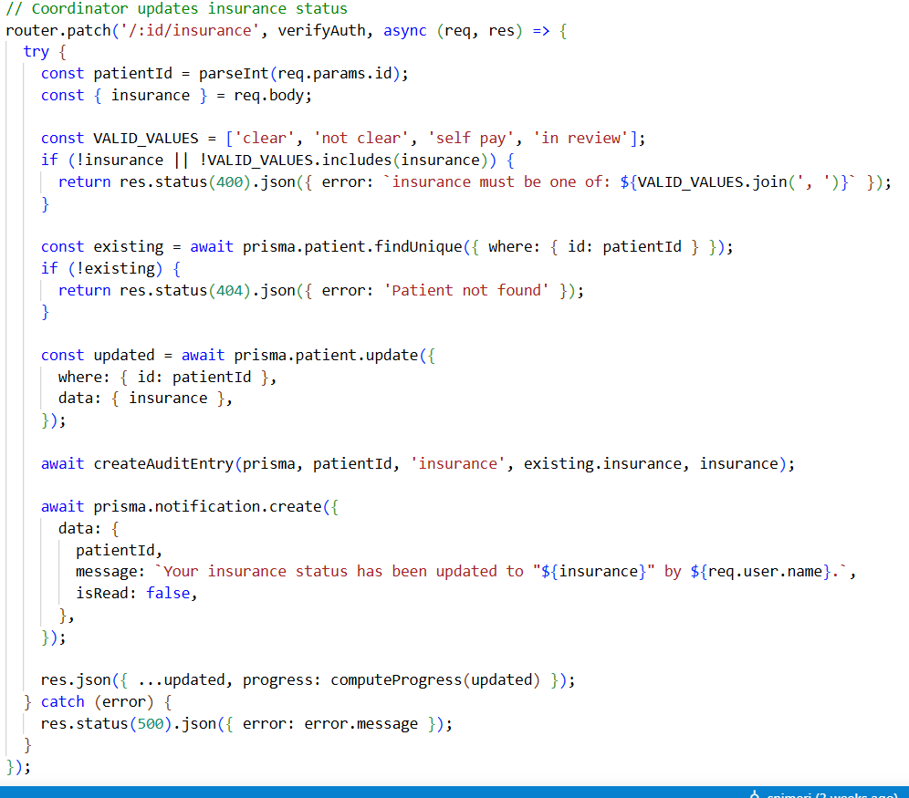
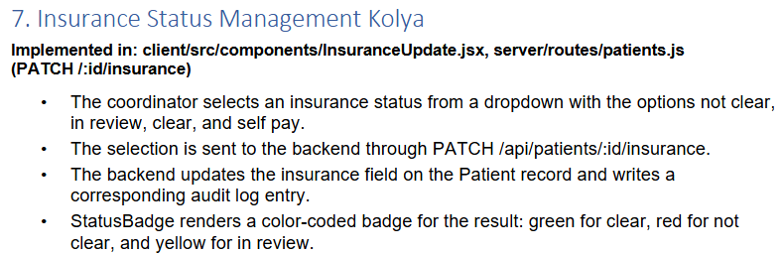
CODE WALKTHROUGH
Insurance Status Management
file/path/here/for/shown/file
CS673 · Team 1 · Iteration 3

Slide 14
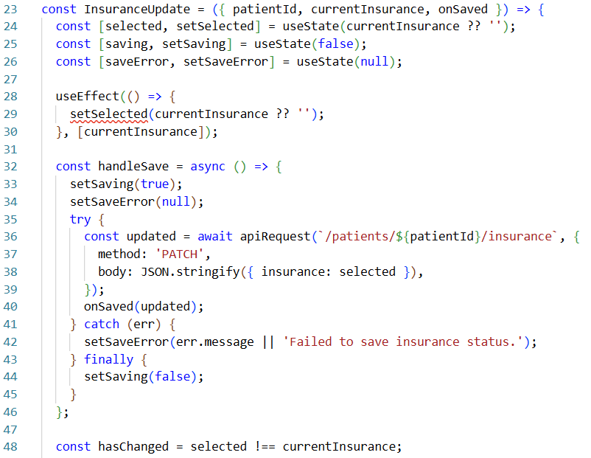
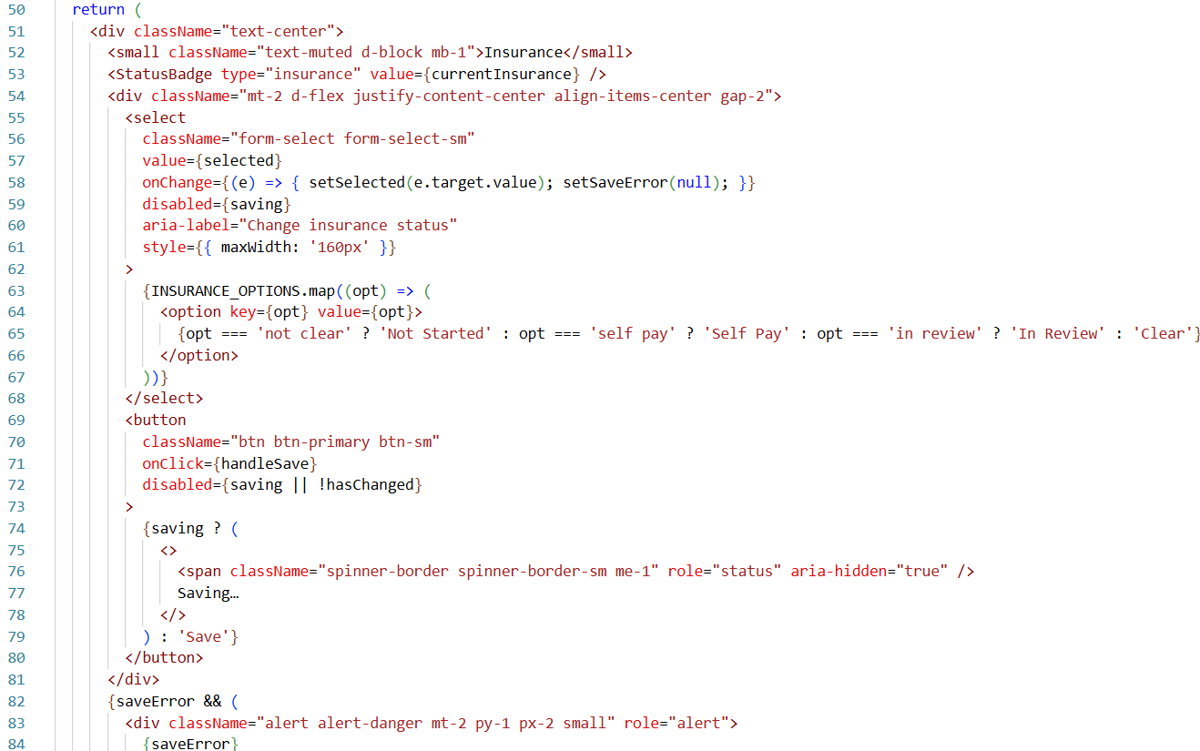

Slide 15
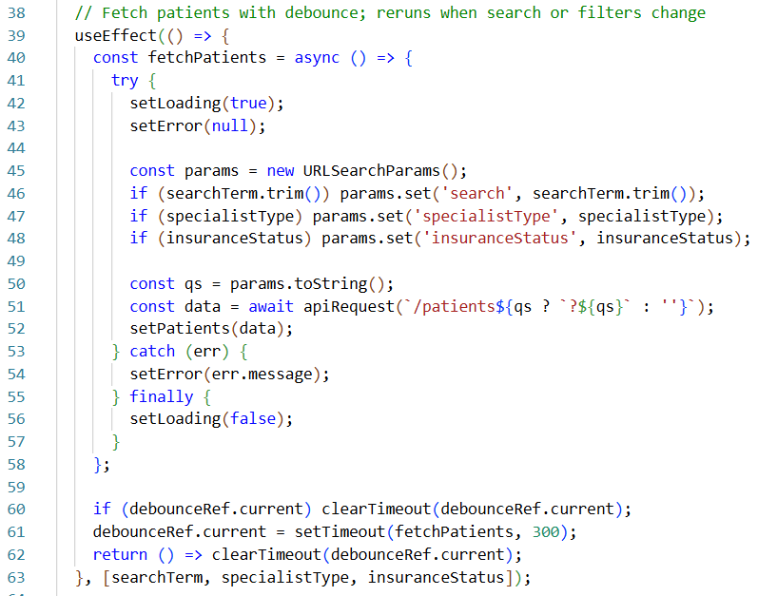
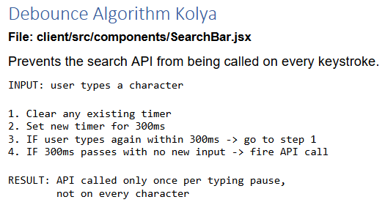
CODE WALKTHROUGH
Debounce Algorithm
file/path/here/for/shown/file
CS673 · Team 1 · Iteration 3

Slide 16
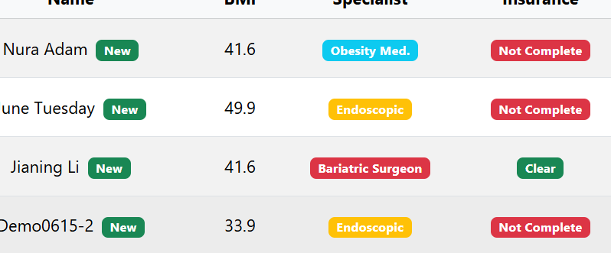
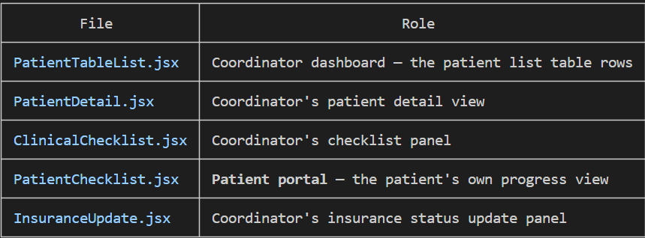
CODE WALKTHROUGH
StatusBadge :Reusable Status Display Component
Implemented in: client/src/components/StatusBadge.jsx
A single React component used throughout the coordinator dashboard
Accepts two props: type (what kind of badge) and value (the raw database value)
Renders a colored Bootstrap badge with a human-readable label
Used in: patient table rows, clinical checklist dropdowns
CS673 · Team 1 · Iteration 3

Slide 17
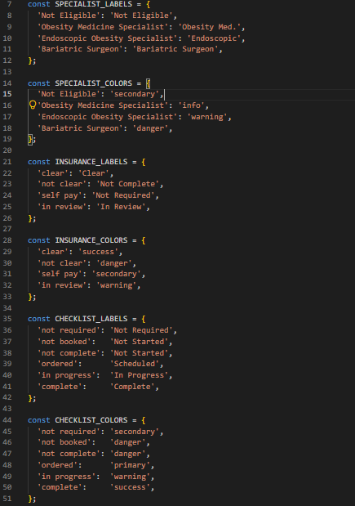
CODE WALKTHROUGH
StatusBadge
Three Badge Types, One Component
Implemented in: client/src/components/StatusBadge.jsx
Type | Value Example | Display as
specialist | "Bariatric Surgeon" | red badge
insurance | "clear" | green badge
checklist | "complete" | green badge
CS673 · Team 1 · Iteration 3

Slide 18
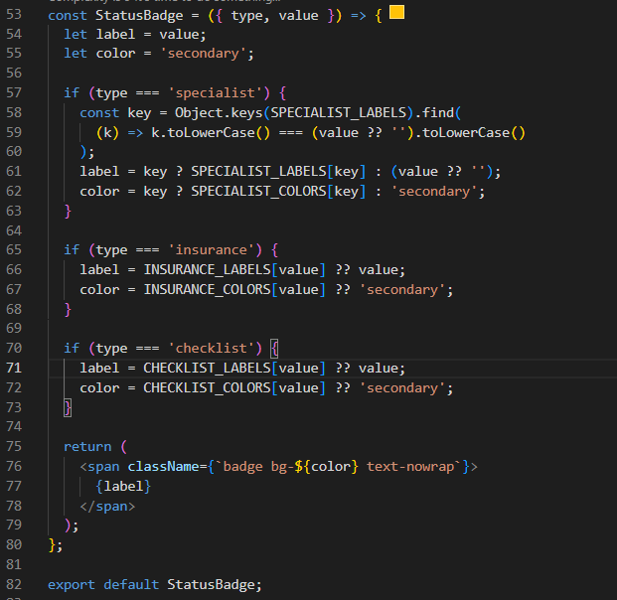
CODE WALKTHROUGH
StatusBadge
Design Pattern Strategy
Implemented in: client/src/components/StatusBadge.jsx
-The component uses the Strategy pattern: the rendering logic stays the same, but the label and color lookup strategy switches based on type
- Each badge type has its own label map and color map
- Adding a new badge type only requires adding a new map no changes to the render logic
Also satisfies:
- SRP :one job: render a colored badge
- OCP :add a new badge type by adding a new lookup table, no existing code changes
- DRY :badge logic centralized here instead of duplicated across 5 files
CS673 · Team 1 · Iteration 3

Slide 19
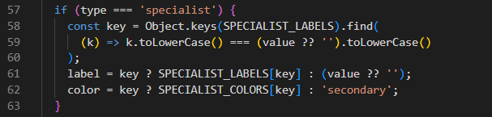
CODE WALKTHROUGH
StatusBadge
Case-Insensitive Specialist Lookup
Implemented in: client/src/components/StatusBadge.jsx
This .find() with .toLowerCase() makes the lookup case-insensitive, so the badge always renders correctly regardless of how the value was stored.
CS673 · Team 1 · Iteration 3

Slide 20

CODE WALKTHROUGH
StatusBadge
Safe Fallback for Unknown Values
Implemented in: client/src/components/StatusBadge.jsx
If value doesn't match any known key, the component falls back gracefully
Label falls back to the raw value string
Color falls back to 'secondary' (gray badge)
The ?? '' null-check prevents crashes if value is null or undefined
CS673 · Team 1 · Iteration 3

Slide 21
CODE WALKTHROUGH
StatusBadge
Test Coverage :Vitest
Full test suite at client/src/__tests__/StatusBadge.test.jsx
Tests cover:
each badge type, known values, unknown values, fallback behavior, case-insensitive specialist lookup
All tests passed
CS673 · Team 1 · Iteration 3

Slide 22
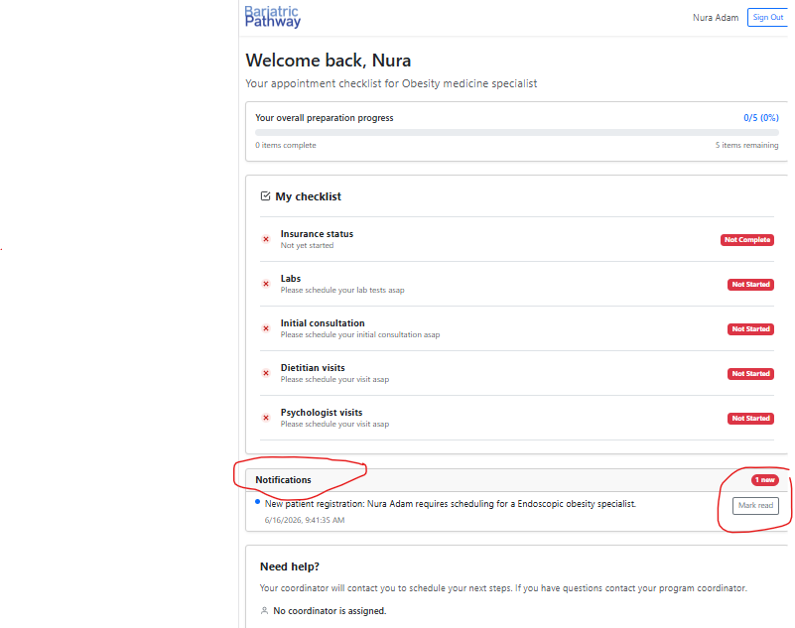
CODE WALKTHROUGH
Coordinator Notifications: Feature Overview
fclient/src/components/NotificationsCard.jsx,
server/routes/notifications.js
Notifications alert the patient when their status changes or when they first submit their profile
Three events trigger a notification:
a. Patient submits their profile → coordinator gets a notification
b. Coordinator updates insurance status → patient gets a notification
c. Coordinator updates a checklist item → patient gets a notification
Notifications are stored in the database and persist across sessions
CS673 · Team 1 · Iteration 3

Slide 23
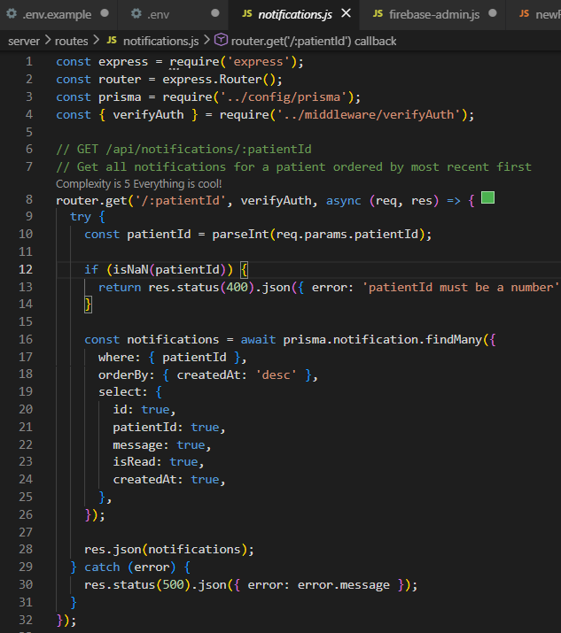
CODE WALKTHROUGH
Coordinator Notifications:
Backend API (notifications.js)
client/src/components/NotificationsCard.jsx,
server/routes/notifications.js
Method | Route | What it does
GET | /api/notifications/:patientId | Fetch all notifications for a patient
PATCH | /api/notifications/:id/read | Mark one notification as read
POST | /api/notifications | Create a new notification
All three routes are protected by verifyAuth must be logged in
GET returns notifications ordered newest first (orderBy: { createdAt: 'desc' })
CS673 · Team 1 · Iteration 3

Slide 24
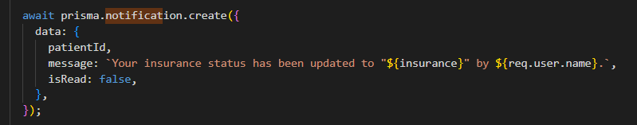
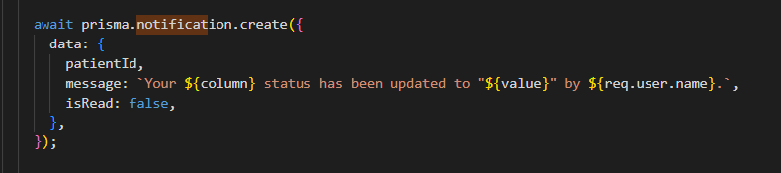
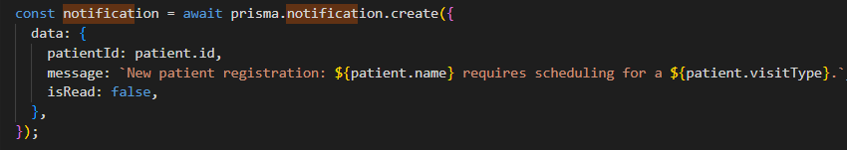
CODE WALKTHROUGH
Coordinator Notifications:
Notifications Are Triggered by Patient Updates
client/src/components/NotificationsCard.jsx,
server/routes/notifications.js
- Notifications are not created through POST /api/notifications directly by the frontend
- They are created automatically inside server/routes/patients.js when:
- A coordinator updates insurance status
- A coordinator updates a checklist column
- A patient submits their profile (line ~298)
- The message includes the coordinator's name: "Your insurance status has been updated to 'clear' by Jane Smith."
CS673 · Team 1 · Iteration 3

Slide 25
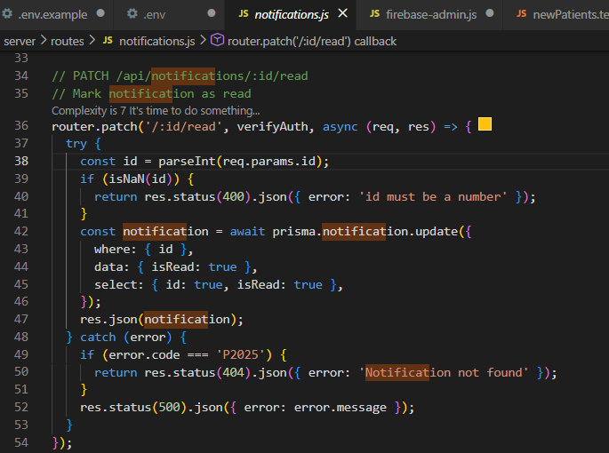
CODE WALKTHROUGH
Coordinator Notifications:
Input Validation and Error Handling
client/src/components/NotificationsCard.jsx,
server/routes/notifications.js
Every route validates its inputs before touching the database
patientId and id must be valid numbers returns 400 if not
message must be a non-empty string returns 400 if missing
Prisma error code P2025 (record not found) is caught and returns 404 instead of a generic 500
All other errors return 500
CS673 · Team 1 · Iteration 3

Slide 26
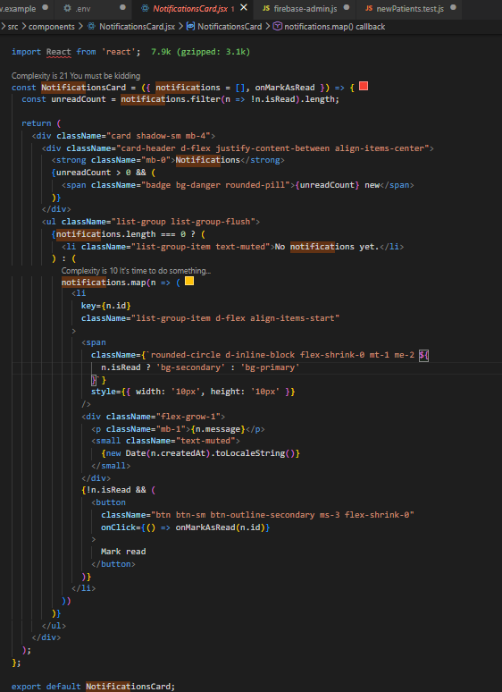
CODE WALKTHROUGH
Coordinator Notifications:
NotificationsCard
Frontend Component
client/src/components/NotificationsCard.jsx,
server/routes/notifications.js
Accepts two props: notifications (array) and onMarkAsRead (callback)
Shows an unread count badge in the header when there are unread notifications
Each notification shows: a colored dot (blue = unread, gray = read), the message, a timestamp, and a "Mark read" button for unread items
Falls back to "No notifications yet." when the list is empty
CS673 · Team 1 · Iteration 3

Slide 27
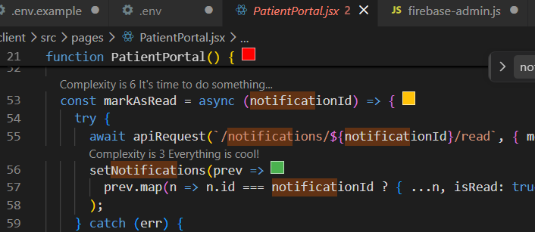
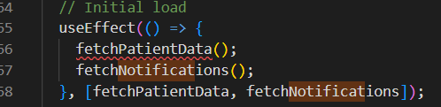
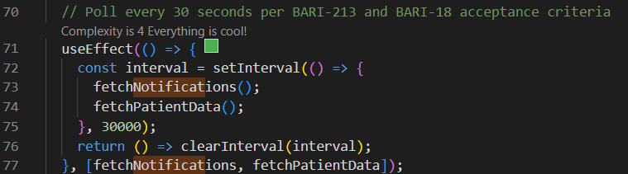
CODE WALKTHROUGH
Coordinator Notifications:
Live Updates Polling Every 30 Seconds
mark as read
client/src/components/NotificationsCard.jsx,
server/routes/notifications.js
PatientPortal.jsx fetches notifications on load and then polls every 30 seconds using setInterval
When "Mark read" is clicked, it calls PATCH /api/notifications/:id/read and updates local state immediately
no re-fetch needed
The interval is cleaned up on unmount to prevent memory leaks
CS673 · Team 1 · Iteration 3

Slide 28
CODE WALKTHROUGH
Backend routes
used by
PatientPortal, CoordinatorDashboard, PatientDetail , DirectorDashboard
GET /api/patients/:id | server/routes/patients.js | used to load patient data on Patient Detail page needed to load checklist data on PatientPortal
PATCH/api/patients/:id/insurance | server/routes/patients.js | for Coordinator insurance dropdown to actually save changes
PATCH /api/patients/:id/clinical | server/routes/patients.js | used for CoordinatorDashboard clinical column dropdowns to save each checklist update
POST /api/notifications | server/routes/notifications.js | Both insurance and clinical PATCH routes call this to notify the patient of every change made . Needed for notifications to show in PatientPortal
GET /api/notifications/:patientId | server/routes/notifications.js | used for Patient Portal notifications section in the patient portal
CS673 · Team 1 · Iteration 3

Slide 29
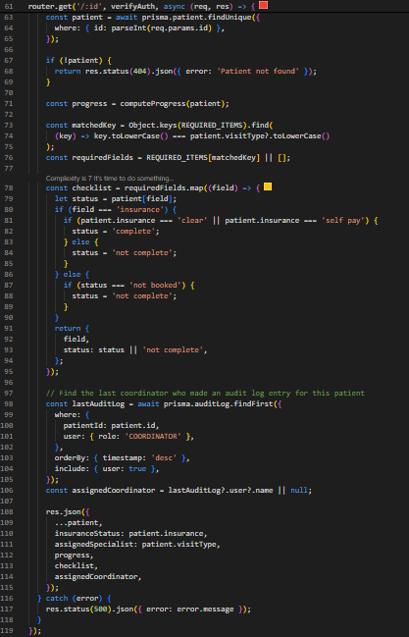
CODE WALKTHROUGH
Backend routes
GET /api/patients/:id Fetch One Patient
server/routes/patients.js
Fetches a single patient by ID and returns everything the patient detail view needs in one response
Computes the patient's progress (completed vs total steps)
Builds the checklist maps each required field to a normalized status (not booked → not complete, insurance mapped to complete/not complete)
Queries the audit log to find the last coordinator who updated this patient and returns their name as assignedCoordinator
CS673 · Team 1 · Iteration 3

Slide 30
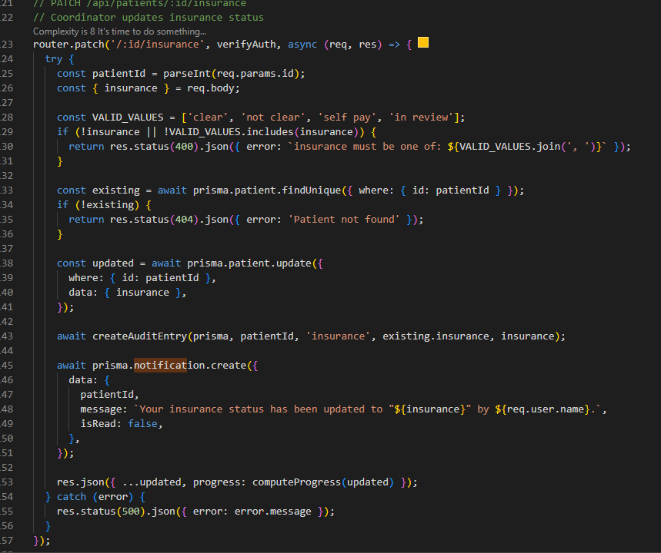
CODE WALKTHROUGH
Backend routes
PATCH /api/patients/:id/insurance Update Insurance Status
server/routes/patients.js
Validates the new value against an allowlist of four values: clear, not clear, self pay, in review
Returns 400 if the value is not in the list
-On success: updates the database, creates an audit log entry, and creates a patient notification
-Returns the updated patient with recalculated progress
CS673 · Team 1 · Iteration 3

Slide 31
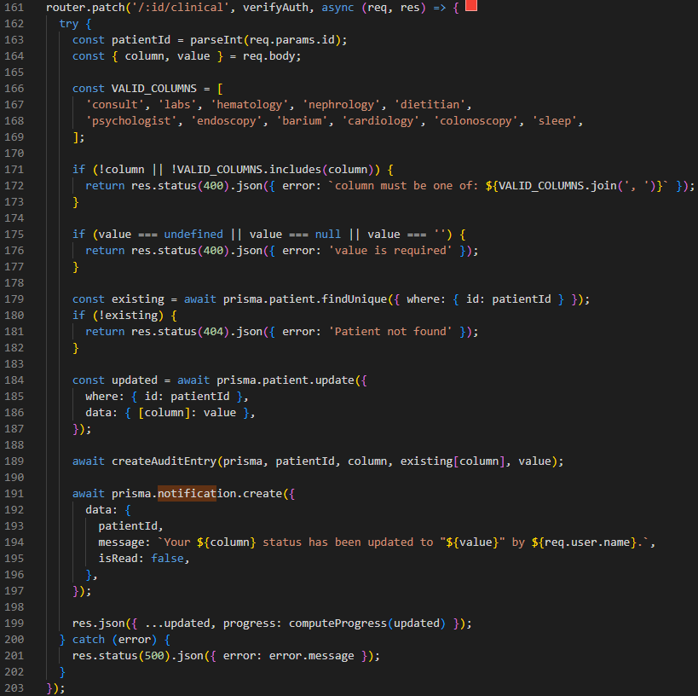
CODE WALKTHROUGH
Backend routes
PATCH /api/patients/:id/clinical Update Clinical Checklist Item
server/routes/patients.js
Handles updates to any of the 11 clinical checklist columns: consult, labs, hematology, nephrology, dietitian, psychologist, endoscopy, barium, cardiology, colonoscopy, sleep
Uses a column allowlist returns 400 if the column name is not recognized
Same three-step pattern as insurance: update → audit log → notification
Uses computed property { [column]: value } to update any column dynamically with one query
CS673 · Team 1 · Iteration 3

Slide 32
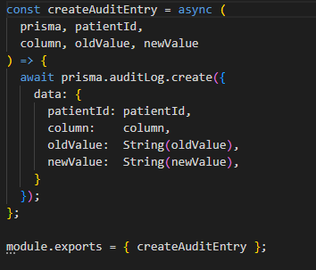
CODE WALKTHROUGH
Audit log utility function createAuditEntry Utility
server/utils/auditUtils.js
A shared utility imported into patient.js and used in both Patch routes instead of repeating the same code twice
Follows DRY principle Do Not Repeat Yourself
Audit log is written once and used everywhere
Every coordinator update (insurance, clinical) calls createAuditEntry from server/utils/auditUtils.js
Records: which patient, which field changed, the old value, the new value
The old value is fetched before the update so it can be stored accurately
Used by both the insurance route and the clinical route centralized so the pattern is consistent
CS673 · Team 1 · Iteration 3

Slide 33




WALKTHROUGH - DIRECTOR DASHBOARD
Director Dashboard
Implemented in: client/src/pages/DirectorDashboard.jsx, client/src/components/PatientMetrics.jsx, client/src/components/SearchBar.jsx
client/src/components/PatientMetrics.jsx
client/src/pages/DirectorDashboard.jsx - Director Dashboard Page
1. Program-wide metrics displayed
PatientMetrics()
// 1. Fetch all patient records
patients ← apiRequest('/patients')
// 2. Calculate aggregate metrics
total ← patients.length
newThisWeek ← count(
patients created within last 7 days
)
insuranceCleared ← count(
patients where insurance = "clear"
)
surgeryReady ← count(
patients where progress.completed = progress.total
)
notEligible ← count(
patients where BMI < 27
)
// 3. Build metric cards
metrics ← {
Total Patients,
Insurance Cleared,
Surgery Ready,
Not Eligible
}
renderMetrics(metrics)
PatientMetrics loads aggregate data across all patients in the program pipeline.
/function DirectorDashboard() {
const { user } = useAuth();
return (
<>
<Navbar />
<ReadOnlyBanner />
<div className="container mt-4">
<h2>Program Director Dashboard</h2>
<p className="text-muted">Pipeline overview — all patients across the program</p>
<PatientMetrics />
<SearchBar disableClick enableSort />
</div>
<AIChatWidget
role="PROGRAM_DIRECTOR"
patientContext={{ role: 'program_director' }}
/>
</>
);
}
2. Read-only access enforced
A ReadOnlyBanner is displayed and SearchBar is rendered with disableClick, preventing directors from opening or modifying individual patient records.
3.Patient list fetched with debounce
On load (and on any search/filter change), a debounced API call fetches patients matching the current search term, specialist type, and insurance status after a 300ms delay.
4. Client-side sorting applied
The fetched results are sorted locally by the selected sort option — date, name, BMI, or progress percentage — without re-fetching from the API.
5. AI assistant available in context
An AIChatWidget is mounted with role: "PROGRAM_DIRECTOR", scoping the AI's context to program-level oversight rather than individual patient data.
CS673 - Team 1 - BariatricPath - Code Walkthrough - Fatimah Hassan
4

Slide 34
WALKTHROUGH - DIRECTOR DASHBOARD
Director Dashboard
Implemented in: client/src/pages/DirectorDashboard.jsx, client/src/components/PatientMetrics.jsx, client/src/components/SearchBar.jsx
client/src/components/SearchBar.jsx
client/src/pages/DirectorDashboard.jsx - Director Dashboard Page
1. Program-wide metrics displayed
SearchBar()
// 1. Build search parameters
params ← {
searchTerm,
specialistType,
insuranceStatus
}
// 2. Fetch patients (300ms debounce)
patients ← apiRequest(
'/patients',
params
)
// 3. Sort results
sortedPatients ← sort(
patients,
date | name | BMI | progress
)
// 4. Render patient list
IF loading
displayLoadingMessage()
ELSE IF no patients found
displayNoResultsMessage()
ELSE
displayPatientCount()
displaySortOptions()
renderPatientTable(sortedPatients)
PatientMetrics loads aggregate data across all patients in the program pipeline.
/function DirectorDashboard() {
const { user } = useAuth();
return (
<>
<Navbar />
<ReadOnlyBanner />
<div className="container mt-4">
<h2>Program Director Dashboard</h2>
<p className="text-muted">Pipeline overview — all patients across the program</p>
<PatientMetrics />
<SearchBar disableClick enableSort />
</div>
<AIChatWidget
role="PROGRAM_DIRECTOR"
patientContext={{ role: 'program_director' }}
/>
</>
);
}
2. Read-only access enforced
A ReadOnlyBanner is displayed and SearchBar is rendered with disableClick, preventing directors from opening or modifying individual patient records.
3.Patient list fetched with debounce
On load (and on any search/filter change), a debounced API call fetches patients matching the current search term, specialist type, and insurance status after a 300ms delay.
4. Client-side sorting applied
The fetched results are sorted locally by the selected sort option — date, name, BMI, or progress percentage — without re-fetching from the API.
5. AI assistant available in context
An AIChatWidget is mounted with role: "PROGRAM_DIRECTOR", scoping the AI's context to program-level oversight rather than individual patient data.
CS673 - Team 1 - BariatricPath - Code Walkthrough - Fatimah Hassan
4

Slide 35
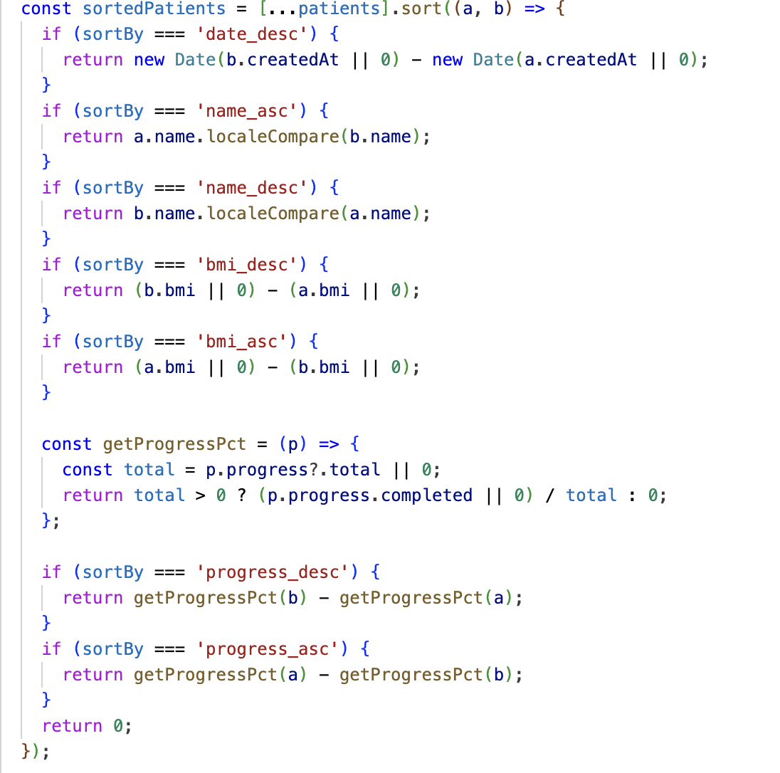
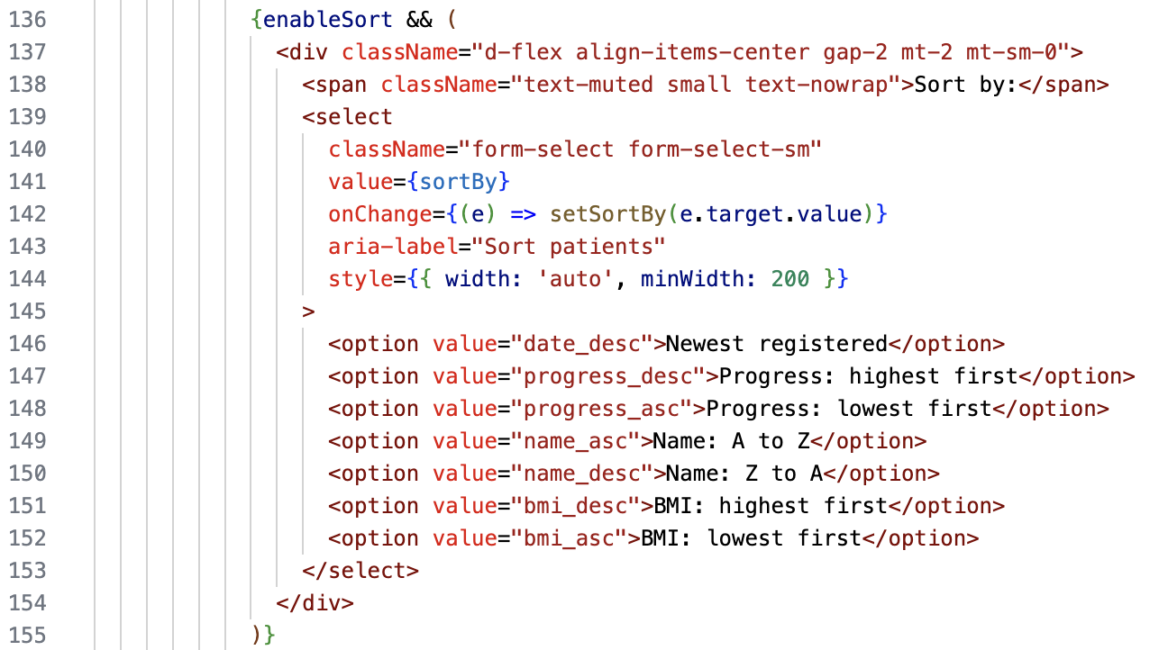
WALKTHROUGH - AI MICROSERVICE
Sorting Functions in Checklist
Flexible Configuration (Reusable Component Design):
Instantaneous Client-Side Sorting:
Comprehensive Sorting Metrics:

Slide 36
WALKTHROUGH - AI MICROSERVICE
AI Chat Assistant
Implemented in: client/src/components/AIChatWidget.jsx, server/routes/ai.js, ai-service/rag.py
server/routes/ai.js - enrich & forward
// Already passed through verifyAuth
router.post('/chat', verifyAuth, async (req, res) => {
const { question, role } = req.body;
const userId = req.user.id;
// 1. Look up this user's real patient data
let context = {};
try {
const patient = await prisma.patient.findUnique({
where: { userId },
select: {
insurance: true,
visitType: true,
progress: true,
},
});
context = patient || {};
} catch (err) {
// Graceful fallback - AI still works
// with whatever the frontend already sent
context = req.body.context || {};
}
// 2. Forward enriched request to the
// internal-only AI microservice
const aiResponse = await axios.post(
'http://ai-service:8000/chat',
{
question,
role,
patient_id: userId,
context,
}
);
res.json(aiResponse.data);
});
1. Same widget, every role
AIChatWidget.jsx is mounted on all three portals. It sends the question plus the user's role - role comes from the verified token, not user input.
2. Express is the gateway
This route already ran verifyAuth - so we KNOW who's asking before we touch the database or the AI service.
3. Real data, not guesses
We fetch the patient's actual insurance/visitType/progress from Postgres via Prisma and merge it into the AI request - the AI answers with real, current data.
4. Internal network only
axios.post to http://ai-service:8000 - that hostname only resolves inside the Docker network. The AI service has no public port.
5. FastAPI takes over
rag.py receives question + role + context and runs the retrieval-augmented generation pipeline (next slide).
CS673 - Team 1 - BariatricPath - Code Walkthrough - Fatimah Hassan
4
Notes:
Speaking points: this is the 'gateway' slide - the key idea is that Express does TWO jobs here: security (verifyAuth already ran) and enrichment (attaching real DB data so the AI isn't just working from whatever the browser sent). The try/catch around the Prisma call is a deliberate design choice - if the DB lookup fails, the AI still responds using whatever context the frontend already had, so a DB hiccup doesn't break the chat feature. Then transition: 'now let's look at what happens once it reaches the AI service' -> move to RAG slide.

Slide 37




WALKTHROUGH - AI MICROSERVICE
Retrieval-Augmented Generation (RAG)
Implemented in: ai-service/rag.py
ai-service/rag.py - generate_response()
MEMORY_WINDOW_SIZE = 7 # exchanges kept & used
RETRIEVAL_TOP_K = 3 # docs retrieved per query
async def generate_response(
question, role, patient_context, session_key
):
# STEP 1 - RETRIEVE
# question -> embedding -> ChromaDB search,
# filtered to this role's collection
docs = vector_store.similarity_search(
question,
k=RETRIEVAL_TOP_K,
filter={"role": role},
)
# STEP 2 - AUGMENT
history = memory.get(session_key, [])
prompt = build_prompt(
system_prompt=ROLE_PROMPTS[role],
retrieved_docs=docs,
patient_context=patient_context,
history=history[-MEMORY_WINDOW_SIZE:],
question=question,
)
# STEP 3 - GENERATE
answer = await llm.ainvoke(prompt)
# STEP 4 - REMEMBER
history.append({"question": question,
"answer": answer})
memory[session_key] = history[-MEMORY_WINDOW_SIZE:]
return {"answer": answer,
"sources": [d.metadata for d in docs]}
STEP 1 - Retrieve
ChromaDB does a similarity search over our 3 CSV knowledge bases. The filter={'role': role} means a patient's question only searches the patient FAQ - never the director's strategic docs.
STEP 2 - Augment
build_prompt() assembles ONE prompt from 4 pieces: the role's system prompt, the retrieved docs, the patient's live data, and the last 7 exchanges (MEMORY_WINDOW_SIZE).
STEP 3 - Generate
The full prompt goes to GPT-4.1-mini via LangChain's llm.ainvoke() - this is the only step that calls OpenAI.
STEP 4 - Remember
The new Q&A pair is appended to an in-memory dict keyed by session_key (role + patient_id), then trimmed back to 7 - a sliding window.
Why this matters
Named constants (MEMORY_WINDOW_SIZE, RETRIEVAL_TOP_K) replaced magic numbers 7/10 from Iteration 2 - one source of truth, documented in code.
CS673 - Team 1 - BariatricPath - Code Walkthrough - Fatimah Hassan
5
Notes:
Speaking points: walk through the 4 steps in order, matching the RETRIEVE -> AUGMENT -> GENERATE -> REMEMBER structure from the document. Emphasize the role filter in step 1 - this is what makes the AI 'role-aware', not just a generic chatbot. In step 2, explicitly say out loud what gets concatenated into the prompt - this is the 'augmentation' in RAG. For step 4, mention this is a documented LIMITATION (not persisted to DB, in-memory only) and that we have a Redis/Prisma path forward documented for production. Close by connecting back to the named-constants refactor - this shows engineering maturity, not just 'AI wrote it and we shipped it'.

Slide 38



WALKTHROUGH - SECURITY & CONFIGURATION
CI/CD Pipeline (GitHub Actions)
Implemented in: .github/workflows/ci.yml, codeql.yml, trivy.yml, zap.yml
.github/workflows/ci.yml (condensed)
name: BariatricPath - CI Tests & Linting
on: [push, pull_request]
jobs:
server-tests:
runs-on: ubuntu-latest
steps:
- uses: actions/checkout@v4
- run: npm ci --prefix server
- run: npm test --prefix server
# Jest + Supertest - 258 tests
client-tests:
runs-on: ubuntu-latest
steps:
- uses: actions/checkout@v4
- run: npm ci --prefix client
- run: npm run test --prefix client
# Vitest - 34 tests
ai-service-tests:
runs-on: ubuntu-latest
steps:
- uses: actions/checkout@v4
- run: pip install -r ai-service/requirements.txt
- run: pytest ai-service/tests
# pytest - 9 tests
lint:
runs-on: ubuntu-latest
steps:
- uses: actions/checkout@v4
- run: npm run lint --prefix client
- run: npm audit --omit=dev
ci.yml - tests & lint
On every push: Jest (258 tests) for the server, Vitest (34) for the client, pytest (9) for the AI service, plus ESLint and npm audit - all in parallel jobs.
codeql.yml - SAST
CodeQL statically analyzes JS + Python source for injection, XSS, and insecure patterns - 'static' means it reads the code without running it.
trivy.yml - container scan
Trivy scans our 3 Docker images and the filesystem for known CVEs and accidentally committed secrets, filtering out unfixed CVEs.
zap.yml - DAST
OWASP ZAP actually RUNS the AI service and attacks it live - 'dynamic' means it tests the running application, not just the source.
Branch protection
dev requires all 4 workflows green plus 1+ reviewer before merge - built incrementally by the Security Lead, one workflow verified at a time.
CS673 - Team 1 - BariatricPath - Code Walkthrough - Fatimah Hassan
6
Notes:
Speaking points: this slide is a good place to define SAST vs DAST out loud since the assignment explicitly asks for these terms - SAST (CodeQL) = analyzing source code without executing it; DAST (ZAP) = attacking the live running app. Mention that this was built INCREMENTALLY - each workflow was added and verified green before the next was added, which is itself a process/quality practice worth mentioning. Close with the branch protection rule tying it all together: nothing reaches dev unless tests + SAST + container scan + DAST all pass.

Slide 39
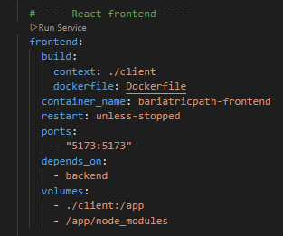
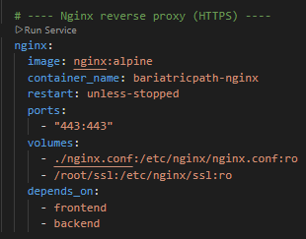
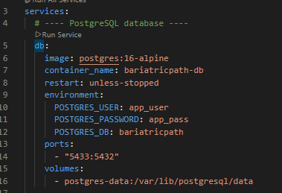
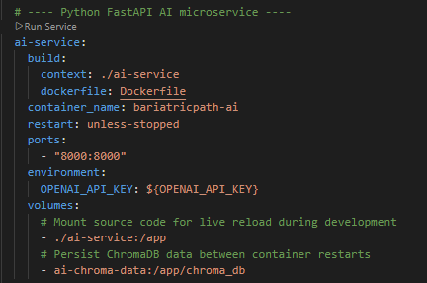
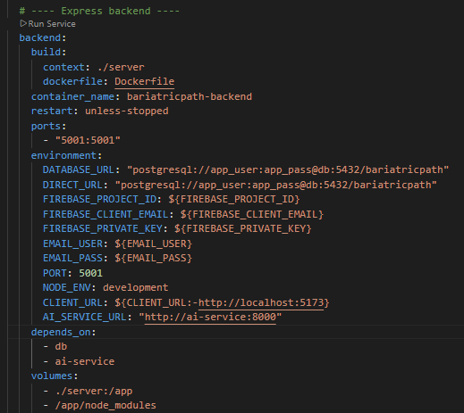
CODE WALKTHROUGH
Manual Deployment to DigitalOcean
App is deployed on a DigitalOcean droplet at https://67.205.191.149
Deployment steps (done manually):
a. SSH into the droplet
b. git pull origin main
c. docker compose up -d --build
Nginx reverse proxy handles HTTPS (self-signed certificate) on port 443
All five services start automatically: React frontend, Express backend, FastAPI AI service, PostgreSQL, Nginx
All five services start automatically: React frontend, Express backend, FastAPI AI service, PostgreSQL, Nginx
CS673 · Team 1 · Iteration 3

Slide 40
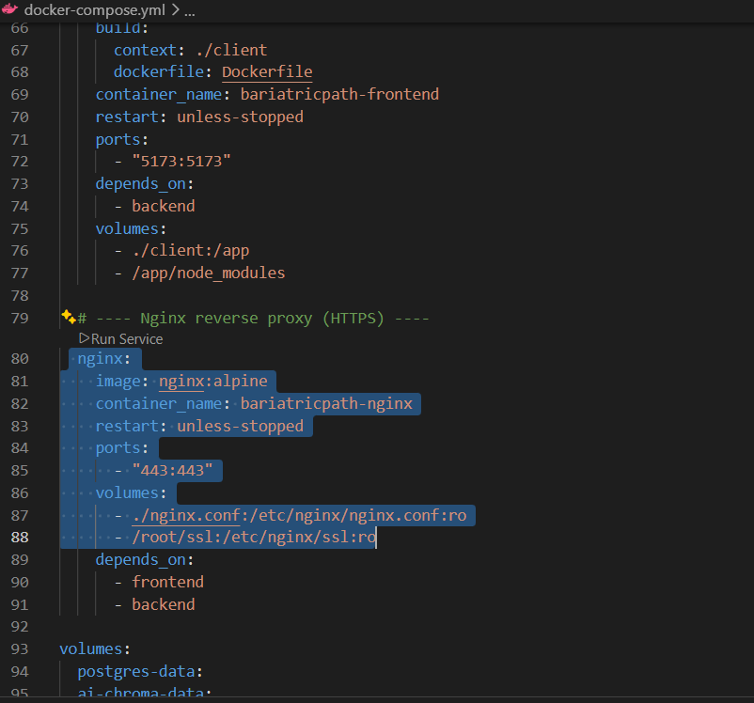
CODE WALKTHROUGH
HTTPS & Nginx
docker-compose.yml
Niginx service block from Docker-compose.yml
Implemented in: nginx.conf, docker-compose.yml
Nginx runs as a Docker container and acts as a reverse proxy in front of the application
A self-signed SSL certificate is stored in /root/ssl on the droplet and mounted into the Nginx container
All HTTPS traffic on port 443 is terminated at Nginx and routed by path: /api/* is forwarded to the backend (port 5001), all other requests are forwarded to the frontend (port 5173)
HTTP traffic on port 5173 remains directly accessible on the droplet as a secondary access point
CS673 · Team 1 · Iteration 3

Slide 41
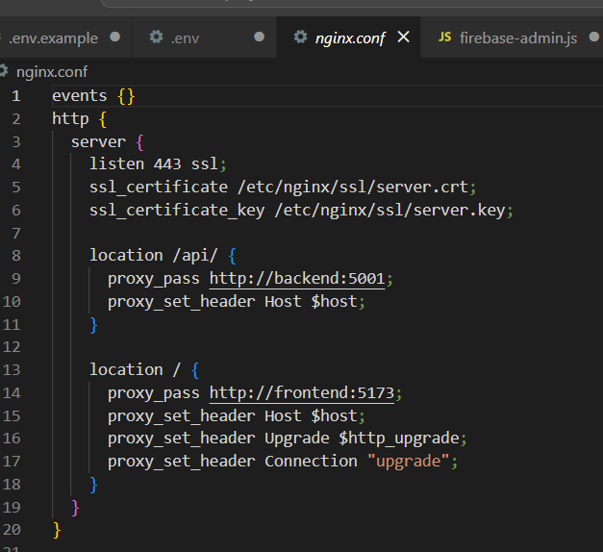
CODE WALKTHROUGH
HTTPS & Nginx
fngix.config
listen 443 ssl : HTTPS on port 443
ssl_certificate /etc/nginx/ssl/server.crt : the self-signed cert
location /api/ → proxy_pass http://backend:5001 : API routing
location / → proxy_pass http://frontend:5173 : frontend routing
CS673 · Team 1 · Iteration 3

Slide 42
CODE WALKTHROUGH
HTTPS & Nginx
Docker containers running on Droplet
CS673 · Team 1 · Iteration 3

Slide 43
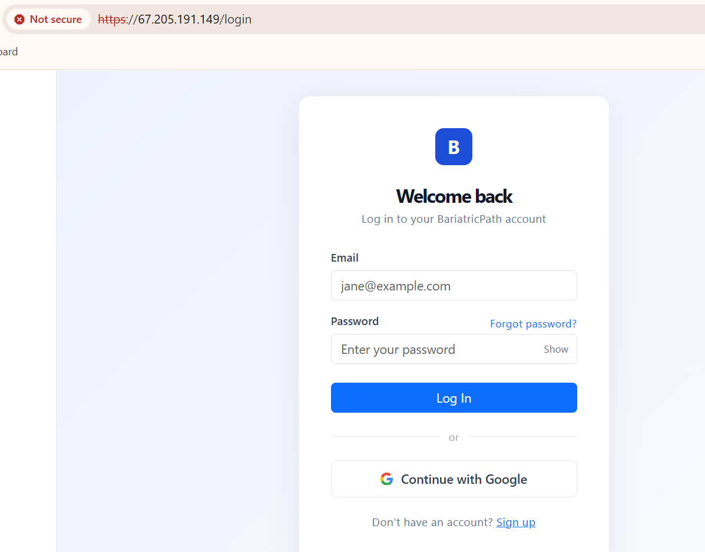
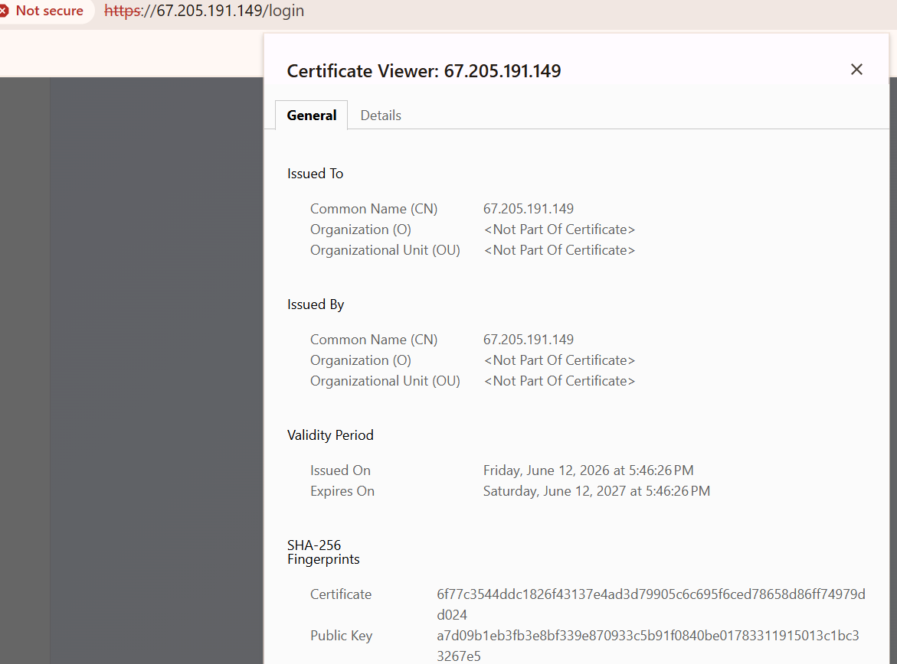
CODE WALKTHROUGH
HTTPS & Nginx
App is deployed on URL https://67.205.191.149 using HTTPS and self certificate
CS673 · Team 1 · Iteration 3

Slide 44
02
Important Algorithms
How we handle complex requests and logics
CS673 - Team 1 - BariatricPath - Final Iteration - Summer 2026
8

Slide 45

CODE WALKTHROUGH
Specialist Recommendation Algorithm
server/utils/routingLogic.js
A rule-based decision algorithm that determines which specialist a patient should see based on their BMI and surgery history.
CS673 · Team 1 · Iteration 3

Slide 46
CODE WALKTHROUGH
Clinical Field Initialization Algorithm
file/path/here/for/shown/file
CS673 · Team 1 · Iteration 3

Slide 47
CODE WALKTHROUGH
New Patient Detection Algorithm
file/path/here/for/shown/file
CS673 · Team 1 · Iteration 3

Slide 48
CODE WALKTHROUGH
Token Refresh and Authentication Algorithm
file/path/here/for/shown/file
CS673 · Team 1 · Iteration 3

Slide 49
WRAP-UP
Thank you
Team 1 — BariatricPath
Kai · Shaima · Kolya · Jianing · Fatimah
CS673 Software Engineering — Summer 2026
CS673 · Team 1 · Iteration 2
13 / 13

